Slide 1
COMP6049 – Algorithm Design and Analysis
Topic 12 – Dynamic Programming: Fibonacci Sequence

Slide 2
Outline Materials
Concept of Dinamic Programming
Fibonacci sequence problem
Solving Fibonacci Sequence problem

Slide 3
DYNAMIC PROGRAMMING
Dynamic Programming is a method of solving a problem that can be used if the solution of a problem can be viewed as a sequence of several decisions.
Dynamic Programming vs. Greedy Method
Dynamic Programming generate the optimal solution, because it does not use local optimum like Greedy Method.
Dynamic Programming vs. Naive Method
Naive method: counting all Feasible Solutions.
Dynamic Programming is not necessary to calculate all possible, saving much time and more efficient.

Slide 4
DYNAMIC PROGRAMMING APPLICATIONS
Fibonacci Sequence Problem
Coin Change Problem
Multistage Graph Problem
Travening Salesman Problem
0/1 Knapsac Problem

Slide 5
FIBONACCI SEQUENCE
Fibonacci Sequence is a sequence in which each element is the sum of two previous elements.
Suppose that we have Fibonacci sequence
f(1),f(2),f(3),f(4),...
f(3) is f(1)+f(2),
f(4) is f(2)+f(3),
and so on.

Slide 6
FIBONACCI USING NAÏVE METHOD
1 module fibo(n)
2 if (n=0) or (n=1) then
3 result=n
4 else
5 result=fibo(n-1)+fibo(n-2)
6 end if
7 end module
1 for i=1 to 100 do
2 display fibo(i),” ”
3 end for

Slide 7
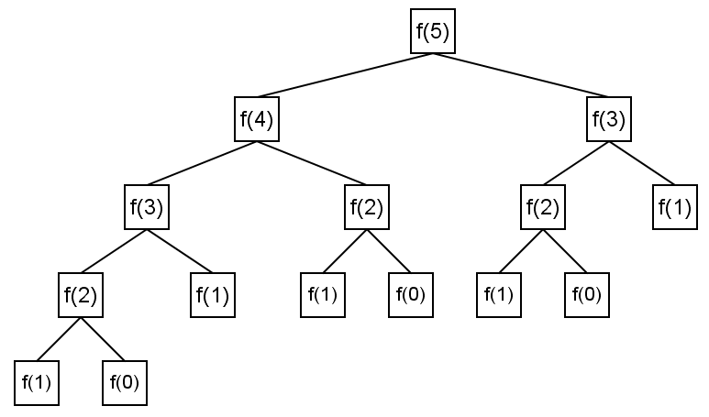
RECURSIVE CALL TREE

Slide 8
NUMBER OF FUNCTION CALLS
N | Number of cunction calls
1 | 1
2 | 3
3 | 5
4 | 9
5 | 15
6 | 25
7 | 41
8 | 67
... | ...
100 | 1.146.295.688.027.634.168.201

Slide 9
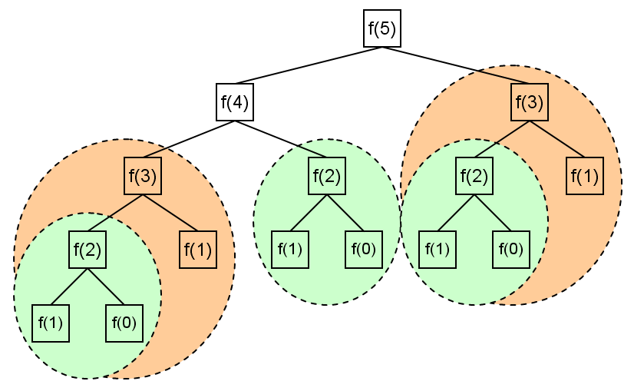
REDUNDANCY

Slide 10
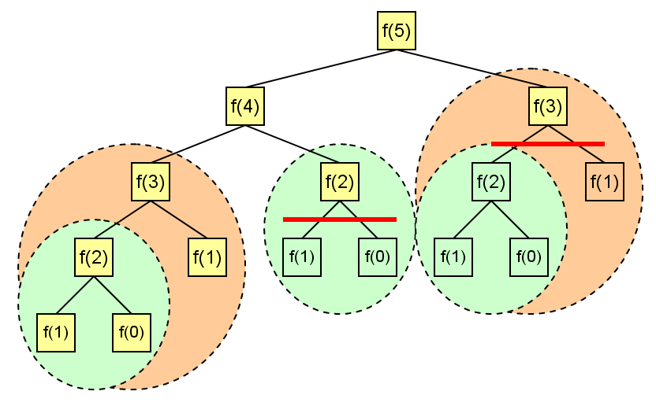
MEMOIZATION
Momoization is a technique of saving values that have already been calculated.

Slide 11
NUMBER OF FUNCTION CALLS
After adding memoization
N | Number of function calls
1 | 1
2 | 3
3 | 5
4 | 7
5 | 9
6 | 11
7 | 13
8 | 15
... | ...
100 | 199

Slide 12
FIBONACCI USING MEMOIZATION
1 module fibo(n)
2 if (n=0) or (n=1) then
3 result=n
4 else
5 if F[n]=0 then
6 F[n]=fibo[n-1]+fibo[n-2]
7 end if
8 result=F[n]
9 end if
10 end module
1 for 1=1 to 100 do
2 F[i]=0
3 end for
4 for i=1 to 100 do
5 display fibo(i),” ”
6 end for

Slide 13
TOP-DOWN vs BOTTOM-UP
Top-Down
Trying to achieve the final result by calculating the components making up these results.
Usually, this is a recursive function.
Bottom-Up
Trying to form a solution by calculating from the beginning, in a structured way towards a solution.
Usually, using looping control.

Slide 14
EXERCISE
Fibonacci with memoization pseudocode contained in the explanation of this meeting using Top-Down approach. Make a version of its Bottom-Up!
Explain how it works!

Slide 15
REVIEW
DYNAMIC PROGRAMMING
DYNAMIC PROGRAMMING APPLICATIONS
FIBONACCI SEQUENCE
FIBONACCI USING NAÏVE METHOD
RECURSIVE CALL TREE
NUMBER OF FUNCTION CALLS
REDUNDANCY
FIBONACCI USING MEMOIZATION
TOP-DOWN vs BOTTOM-UP

Slide 16
Q & A

Slide 17
References
S. Sridhar. 2014. Design and Analysis of Algorithms, 1/e. Oxford University Press. India. Chapter 13
Ellis Horowitz,Sanguthevar Rajasekaran,Sartaj Sahni. 1998. Computer algorithms/C++. 1STBL. New York. Chapter 5.1 and Chapter 5.3
Dynamic Programming
http://www.algorithmist.com/index.php/Dynamic_Programming

Slide 18
THANK YOU

